Slide 1
Sheet 1

Slide 2
What is meant by distributed system?
We define a distributed system as a collection of autonomous computers linked by a network, with software designed to produce an integrated computing facility.
A system in which hardware or software components located at networked computers communicate and coordinate their actions only by message passing.
A collection of two or more independent computers which coordinate their processing through the exchange of synchronous or asynchronous message passing.
A collection of independent computers that appear to the users of the system as a single computers.

Slide 3
What are the significance of distributed system?
a. Concurrency of computers.
b. No global clock.
c. Independent failures

Slide 4
What is process migration?
Process migration is the relocation of a process from its current location to another node.
• It may be migrated either before it starts executing on its source node or during the course of its execution. • The former is known as non-preemptive process migration and, • The latter is known as preemptive process migration. • Preemptive process is costlier than non-preemptive.

Slide 5
List the steps for process migration?
• Selection of process that should be migrated. • Selection of the destination node to which the selected process should be migrated. • Actual transfer of the selected process to the destination node. • Once we identify the process to be migrated and where it is migrated, the next step is to carry out process migration.

Slide 6
What is the advantage of process migration?
Balancing the load: o It reduces average response time of processes
o It gains higher throughput • Moving the process closer to the resources it is using:
o It utilizes resources effectively. • It can be able to move a copy of a process (replicate) on another node to improve system reliability. • A process dealing with sensitive data may be moved to a secure machine to improve security.

Slide 7
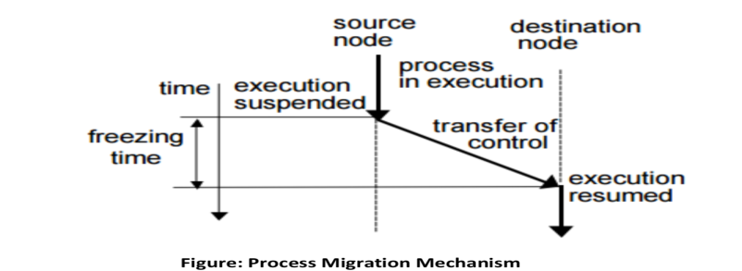
Process migration mechanism

Slide 8
What is ordered message delivery?
• In this type of Communication, multiple senders send messages to a single receiver. • A Selective receiver specifies a unique sender i.e. the message transfer takes place only from that sender. • In case of non-selective receivers, a set of senders are specified from which the message transfer can take place.

Slide 9
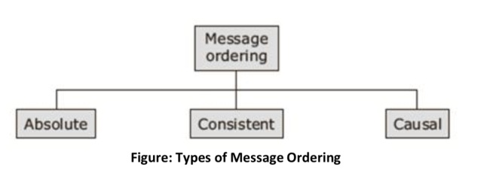
What are the various semantics for the Message ordering ?

Slide 10
Explain how each of these semantics is implemented?
To Explain the various ordering mechanism, we use the following notations: • S for Sender Process • R for Receiver Process • T for Time stamp included in the message • M for Message • The Time increases from top to bottom along the Y-axis.

Slide 11
Absolute Ordering
• Absolute ordering semantics includes that the sender delivers all the messages to all the receiver processes in the exact order in which they were sent. • This semantic can be implemented by using a global timestamp embedded in the message as an ID. • Each machine in the group has its clock synchronized with the system clock. • The receiver machine kernel saves all messages from one process into a queue.

Slide 12
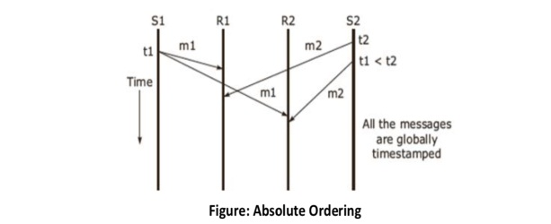
Cont.
Here, S1 sends a message to R1 and, R2 at time t1 followed by S2 sending the message to R1and R2 at time t2. • tl < t2. • R1 and R2 receive
the messages
ml and m2 and will order
them as m1 followed by m2.

Slide 13
Consistent Ordering
The absolute ordering technique needs a globally synchronized clock. • S1 sends a message to Rl and R2 at time t1, followed by s2, sending the message to Rl and R2 at time t2. • The two timestamps, t1 and t2, attached to the messages are such that t1< t2. • Rl and R2 received either the messages m1 followed by m2, or m2 followed by m1.

Slide 14
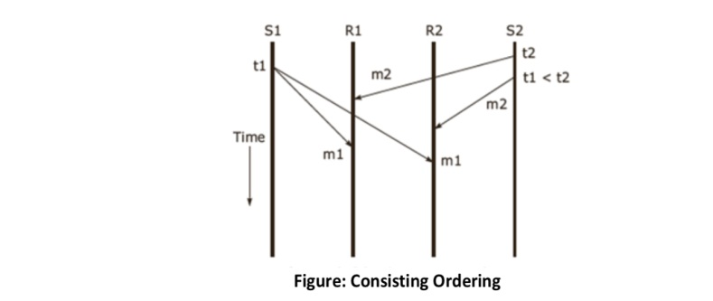
Cont.

Slide 15
Cont.
The ABCAST protocol of the ISIS system is a distributed algorithm, which implements the consistent- ordering semantics. • ABCAST implements the sequencer method as given below: • The sender uses an incremental counter to assign a sequence number to the message and multicasts it. • Each member receives the message and returns a-proposed sequence number to the sender. • Member i calculates the sequence number from the function:
max(Fmax,Pmax)+1+i/N

Slide 16
Cont.
• Where Fmax is the largest final sequence number mutually agreed upon by the group (Noted by all members). • Pmax is the largest proposed sequence number, and N is the total number of members of the multicast group.

Slide 17
Causal ordering
• Causal ordering gives better performance than the other techniques. • This semantic ensures that the two messages are delivered to all receivers in correct order if they are causally related to each other. • S1 sends a message to R1, R2, and R3 at time t1 followed by S2 sending the message to R1, R2, and R3 at time t2. • The two timestamps, t1 and t2, attached to the messages are such that t1< t2. • After receiving message m1, R1 sends a message m3 to R2 and R3. • Based on causal ordering semantics, m1 and m3 are causally related to each other. • Hence, they need to be ordered at R1 and R2, but there is no ordering required for messages at R3.

Slide 18
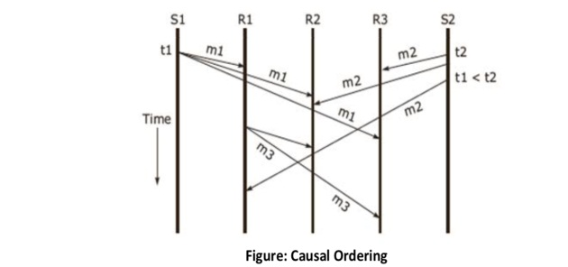
Cont.

Slide 19
What are various issues while designing load balancing algorithm
There are various issues involved in designing a good load-balancing algorithm, these are as follows: • Load estimation policies • Process transfer policies • Static information exchange policies • Location policies • Priority assignment policies
• Migration limitation policies

Slide 20
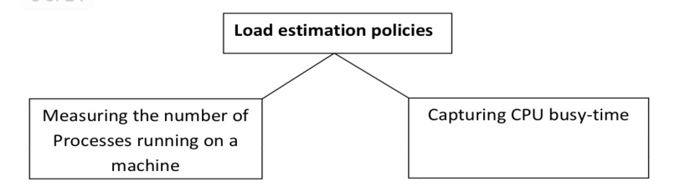
load estimation policies
The various methods adopted for load estimation are based on the number of processes running on the machine and capturing CPU busy-time.
The classification of load estimation policies are as follows

Slide 21
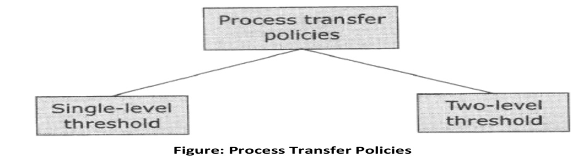
Process Transfer policy
Process transfer policies are used to decide the time when a process should be transferred.
It is based on a threshold.
The threshold level can be either a single or a two level threshold policy.

Slide 22
Single level threshold
o A node accepts a new process as long as its load is below the threshold, else it rejects the process as well as the request for remote execution. o The use of this single threshold value may lead to useless process transfer, leading to instability.

Slide 23
Two Level Threshold Policies
o A two level threshold policy is preferred to avoid instability.
o It has two threshold level: High and Low Marks o The load states of a node can be divided into three regions:
o Overloaded (above high mark) o Normal (above low mark and below high mark) o Under-loaded (below low mark)

Slide 24
Location policies
The location policy is used to select the destination node where the process can be executed. • The location policies are classified as below.
Threshold policy
Shortest location policy
Bidding location policy
Pairing policy

Slide 25
Priority assignment policies
For process migration in distributed system, priority assignment policy for scheduling local and remote processes at a node is necessary.
Priority policies are classified as below:
Selfish priority assignment policy.
Altruistic priority assignment policy.
Intermediate priority assignment policy.

Slide 26
Selfish priority assignment policy
o Local processes are given higher priority are compared to remote processes. o The priority of a process depends on the number of local processes and the number of remote process at a specific node. o Gives the worst response-time performance for remote processes, but it is best for local processes.

Slide 27
Altruistic priority assignment policy
In altruistic policy remote processes are given higher priority than local processes.
This policy has the best response-time performance.

Slide 28
Intermediate priority assignment policy
The intermediate policy gives a higher priority to local processes if the number of local processes is greater than the remote processes; else remote processes are given higher priority.
The performance of intermediate priority assignment policy falls between selfish and altruistic priority assignment policies.

Slide 29
Migration limitation policies
In a distributed system, it is important to decide the number of times a process is allowed to migrate.
There are two types:
Uncontrolled.
Controlled.

Slide 30
What is a deadlock?
• A deadlock is a fundamental problem in distributed systems. • A deadlock is a state where a set of processes request resources that are held by other processes in the set. • Suppose a process holds resource A and requests resource B, while at the same time another process holds resource B and requests for resource A. Here, both are blocked and remain so.

Slide 31
Difference between DS and single processor system
Deadlocks in distributed systems are similar to deadlocks in single processor systems, but only worse. This is how they differ: • They are harder to avoid, prevent, or even detect. • They are hard to cure when tracked down because all relevant information is scattered over many machines.

Slide 32
Classification of Distributed Deadlocks
Distributed deadlocks are classified into
1- Communication deadlocks
2- Resource deadlocks

Slide 33
Communication deadlocks
• This type of deadlock occurs among a set of processes when they are blocked and waiting for messages from other processes in order to start execution. • There are no messages in transit between them. • Due to this reason, none of the processes will ever receive a message. Hence, all processes in the system are deadlocked. • A typical example is that of processes competing with buffers for send/receive operation.

Slide 34
Resource deadlocks
• This type of deadlock occurs when two or more processes wait for resources held by each other. • For example, exclusive access on I/O devices, files, and other resources.

Slide 35
Four conditions must hold for deadlock to occur:
• Exclusive use – when a process accesses a resource, it is granted exclusive use of that resource. • Hold and wait – a process is allowed to hold onto some resources while it is waiting for other resources. • No preemption – a process cannot preempt or take away the resources held by another process. • Cyclical wait – there is a circular chain of waiting processes, each waiting for a resource held by the next process in the chain.

Slide 36
Deadlock prevention
the three important deadlock prevention methods are:
o Collective Requests
o Ordered requests
o Pre-emption

Slide 37
Collective Requests
• This method denies the hold-and-wait condition by ensuring that whenever a process requests for a resource, it does not hold any other resources. • A process must collect all its resources before it commences execution. • Any one of the following resource allocation policies can be used: o Either all Resources allocated, or Process waits. o Hold and Request not allowed, if holding some resources then release the resource and Re-request the necessary resource.

Slide 38
Ordered Requests
o A process can request a resource at any time, but the process must not request a resource with a number lower than the number of any of the resources that it is already holding. o The ordering of requests is based on the usage pattern of the resources. o For example if a tape drive is usually needed before a printer, the tape drive can assign a lower number than a printer. o Reordering will be essential when new resources are added to the system. o In spite of these limitations, the method of ordered requests is the most efficient method for handling deadlocks.

Slide 39
Pre-emption
A pre-emptable resource is a resource whose state can be saved and restored later.
• The resource can be taken away temporarily from the process to which it is currently allocated without disturbing the computation performed. • Typical examples of pre-emptable resources are CPU registers and main memory.

Slide 40
What is a name server? What is namespace?
A name Server (process) is used to maintain information about named objects and enable users to access this name information. • It also binds the object’s name to its property (such as location). • Each name server will store information about a subset of objects in the distributed system.

Slide 41
Cont.
• The authoritative name servers maintain information as bellows: • The root node stores information about only the location of the name servers which branch out from the Root, D1, D2, and D3. • Domain D1 node stores information about domains D4 and D5. • Domain D3 node stores information about domains D6, D7 and D8. • It is evident that the amount of configuration data to be maintained by name servers at various levels in the hierarchy is directly proportional to the degree of branching of the namespace tree. • Hence, a hierarchical naming convention with multiple levels is better suited for a large number of objects rather than a flat namespace.

Slide 42
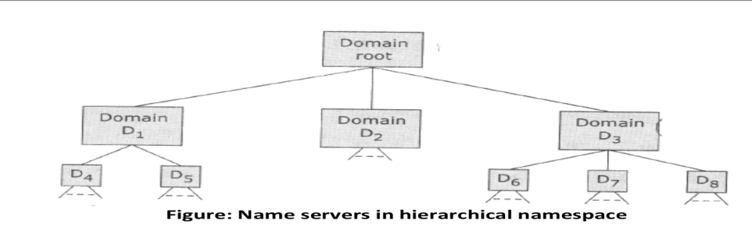
Cont.

Slide 43
Name space
A name space is defined as the set of names within a distributed system that compiles with the naming convention .
Types of Name Space are:
o Flat Namespace o Partitioned Namespace

Slide 44
Why network system protocols are unsuitable for Distributed Systems?
Traditional protocols do not support distributed systems, which have the following requirements:
Transparency
Client-server based communication
Group communication
Security
Network management
Scalability

Slide 45
Versatile message transfer protocol (VMTP):
VMTP supports request/response behavior.
• Provides transparency and group communication, selective retransmission mechanism, rate based control flow. • This connectionless protocol provides end to end datagram delivery.

Slide 46
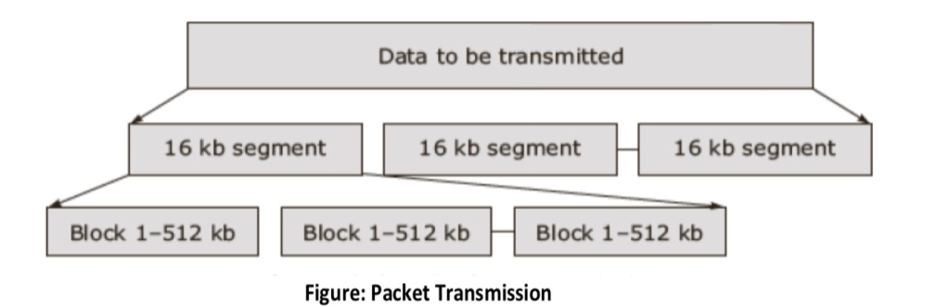
Cont.
• In figure packets divided into 16kb segments, which are split into 512 kb blocks. • Each block consists of data and a 32 bit mask, delivery mask field, indicating data segment in the Packet.

Slide 47
What are the desirable features of good Message Passing system?
The major functions of the message-passing system include :
efficient message delivery
availability of communication progress information.
The message passing model offers various advantages.

Slide 48
Advantages of message passing model
Hardware match
Functionality
Performance
Uniform semantics
Efficiency
Reliability
Correctness
Flexibility
Portability
Security

Slide 49
Why mutual exclusion is more complex in distributed systems?
In distributed systems, Mutual Exclusion is more complex due to the following reasons: • No shared memory • Delays in propagation of information which are unpredictable • Synchronization issues with clocks • Need for ordering of events

Slide 50
Categorize and compare mutual exclusion algorithms.
Several algorithms to implement critical sections and mutual exclusion in distributed systems: • Centralized algorithm • Distributed algorithm • Token Ring algorithm

Slide 51
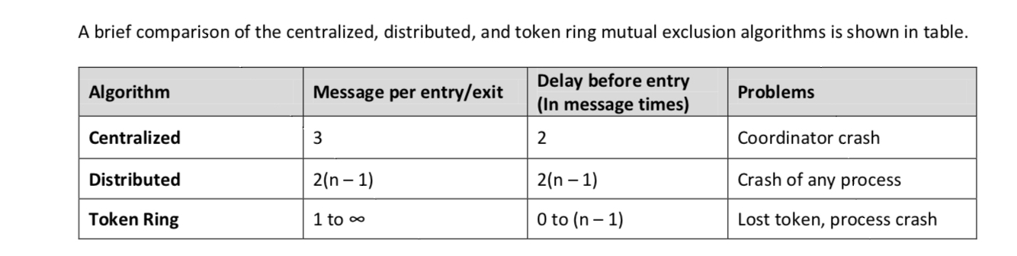
Cont.
A brief comparison of the centralized, distributed, and token ring mutual exclusion algorithms is shown in table.

Slide 52
What is RMI? Discuss the various components and the process of RMI execution
• The server manages the objects and clients invoke the method called the RMI. • The RMI technique sends the requests as a message to the server which executes the method of the object and returns the result message to the client. • Method invocation between objects in the same process is called local invocation. While those between different processes are called remote invocation.

Slide 53
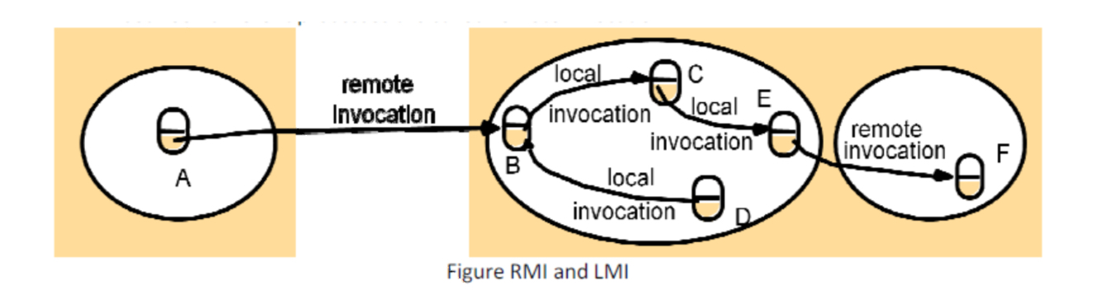
RMI &LMI

Slide 54
Cont.
• Each process contains objects, some of which can receive remote invocations are called remote objects (B, F), others only receive local invocations • Objects need to know the remote object reference of an object in another process in order to invoke its methods, Every remote object has a remote interface that specifies which of its methods can be invoked remotely

Slide 55
Remote Object References
• Accessing the remote object • Identifier throughout a distributed system • Can be passed as arguments

Slide 56
Remote Interfaces
• Specifying which methods can be invoked remotely • Name, arguments, return type • Interface Definition Language (IDL) used for defining remote interface

Slide 57
Main Features of Java RMI
Java RMI has several advantages over traditional RPC systems because it is part of Java's object oriented approach Mobile behavior
Safe and Secure
Easy to Write/Easy to Use
Write Once, Run Anywhere
Parallel Computing

Slide 58
RMI software
This is the middleware layer and consists of the following:
Proxy:
o It makes RMI transparent to the client and forwards the message to the remote object. o It marshals the arguments and the result and also sends and receives messages from the client. o There is one proxy for each remote object for which it holds a remote reference.

Slide 59
Cont.
2) Dispatcher:
o A server consists of one dispatcher and a skeleton for each class which represents a remote object. o This unit receives the request message, selects the appropriate method in the skeleton, and passes the request message.
3) Skeleton:
o It implements the method in the remote interface.

